Slide 1
Program: B. Tech , Branch: CS , Semester:8th (Jan-Jun)2026
Final Report
Synopsis On :
Secure Blockchain Voting System
Guide Name :
Ms. Bhawna Ojha
Submitted by:
Sojwal Sonkusale-0905CS221200
Yogesh Yadav-0905CS221233
Submitted To :
Ms. Bhawna Ojha

Slide 2
Outlines:
Abstract of the project
Implementation of Modules
Screenshots of the output
Applications of the project
Conclusion & Future work

Slide 3
Abstract:
Developed a secure blockchain-based e-voting system using Python.
Implemented SHA-256 hashing for secure and tamper-proof vote storage.
Used Proof-of-Work consensus to validate and secure blockchain blocks.
Prevented duplicate voting through unique voter ID verification.
Designed Web, GUI, and CLI interfaces for flexible user access.
Enabled transparent and real-time election result verification using blockchain.

Slide 4
Implementation of Modules :
1. Blockchain Module
Creates and manages blockchain blocks.
Maintains chain integrity using hashes.
2. Voting Module
Handles voter authentication and vote casting.
Prevents duplicate voting.
3. Mining Module
Implements Proof-of-Work consensus.
Validates new blocks before addition.
+

Slide 5
Implementation of Modules :
4. Web Interface Module
Flask-based responsive voting platform.
5. GUI Module
Tkinter-based desktop voting application.
6. Result & Commission Module
Displays verified constituency-wise election results.
+

Slide 6
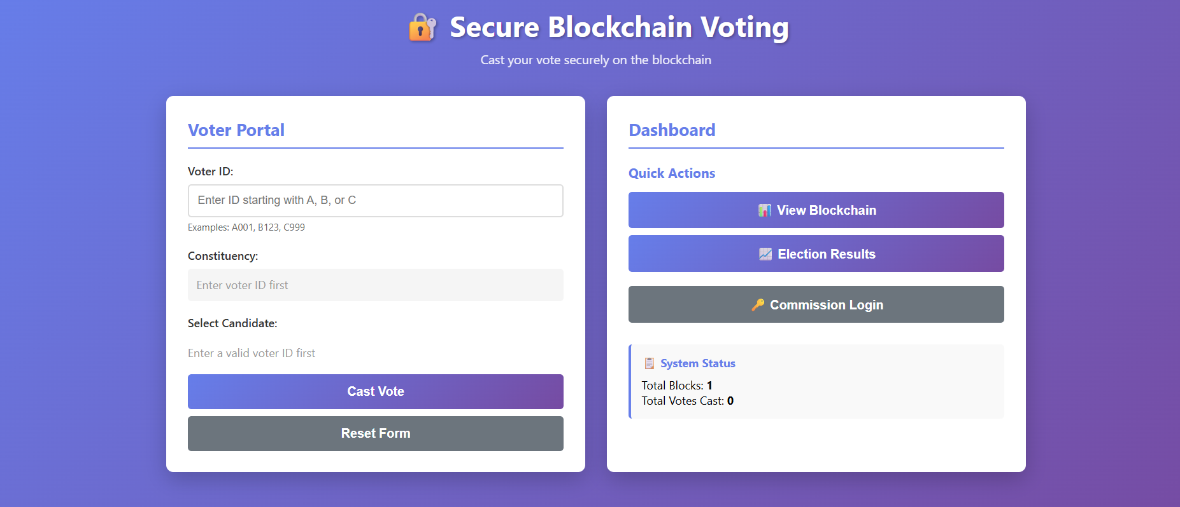
Screenshots of the output

Slide 7
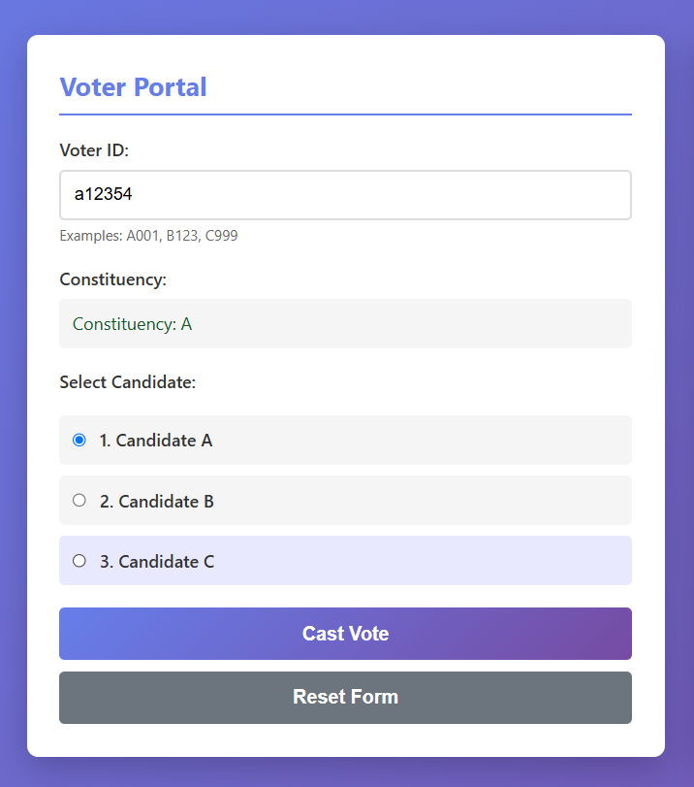
Screenshots of the output

Slide 8
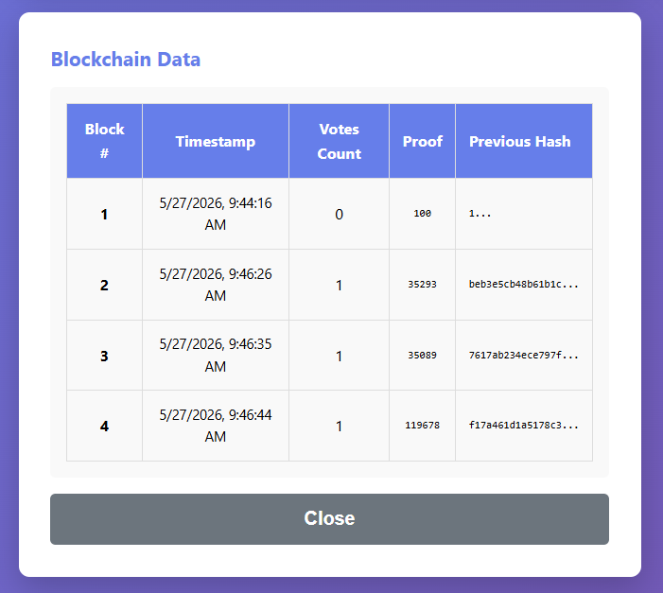
Screenshots of the output

Slide 9
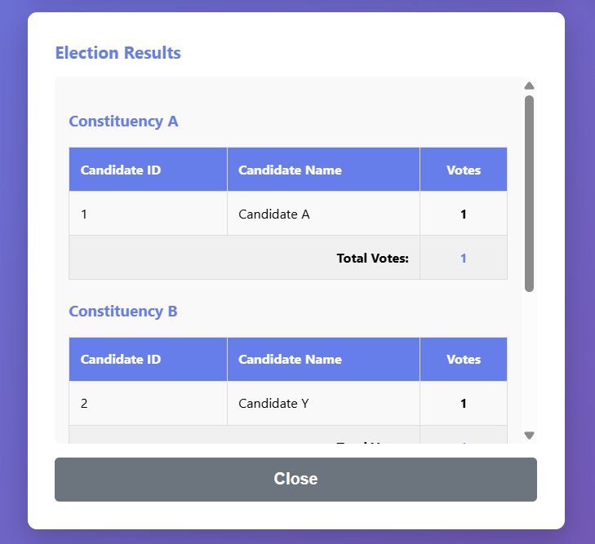
Screenshots of the output

Slide 10
References
Jafar, U., & Aziz, N. A. (2021). Blockchain for electronic voting system—Review and open research challenges. Sensors, 21(17). https://doi.org/10.3390/s21175874
Hajian Berenjestanaki, M., Nguyen, N. G., & Chbeir, R. (2023). Blockchain-based e-voting systems: A technology review. Electronics, 13(1). https://doi.org/10.3390/electronics13010017
Emami, A., Fotouhi, H., & Nazari, M. (2023). A scalable decentralized privacy-preserving e-voting scheme using blockchain. Journal of Information Security and Applications, 73. https://doi.org/10.1016/j.jisa.2023.103417
Yan, S. (2022). Analysis on blockchain consensus mechanism based on proof of work and proof of stake. arXiv. https://doi.org/10.48550/arXiv.2209.11545
Swan, M. (2015). Blockchain: Blueprint for a new economy. O’Reilly Media.

Slide 11


